Slide 1
Chapter 3

Slide 2
PROCESSES:
PROCESS:
A program in execution (including the memory, stack space, program counter – i.e. more than just the code). In other words – a verb.
A process (heavyweight process) has the states (new, ready, running, waiting, terminating).
  Includes program code, data, system resources, memory, program counter,
  register set, and stack space.
  Can create child processes.
  Cannot be shared among different tasks.
  Both the OS and users can execute processes.

Slide 3
PROCESSES:
PROCESS CONTROL BLOCK (PCB):
A data structure containing:
  Process identifier.
  The process state (new, ready, running, waiting, terminating).
  Process priority.
  The program counter.
  Memory management information.
  I/O status information.
  Accounting information.
  CPU scheduling information.
  Etc (OS dependent).
On a single CPU time-shared system, only 1 process can be executing at any given instance. Therefore, we must occasionally swap the running process with a waiting process – this swapping is called a context switch (in reality we only swap the PCBs).

Slide 4
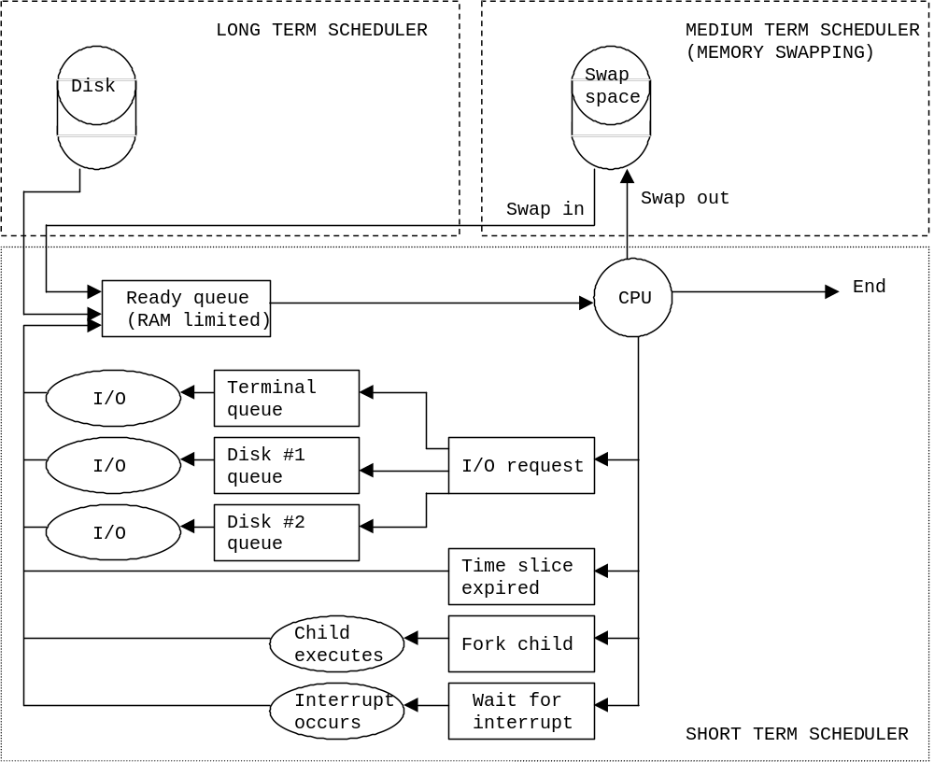
PROCESSES:

Slide 5
PROCESSES:
PROCESS CREATION:
  Parent – creates sub-processes.
  Child – the sub-process.
A child may get resources from its parent (forced to share the parents – prevents system overload) or from the OS.
A child may run concurrently with the parent or the parent may wait for the child to finish.
PROCESS TERMINATION:
Parent can kill child processes. Reasons include:
  Child exceeds resources allocated.
  Task assigned to child no longer needed.
  Parent is terminating (children should not exist without a parent). However, if a parent terminates before a child, the child may be adopted by the "init" process (pid = 1) and is allowed to run to completion.
Child can terminate and optionally return data to parent.

Slide 6
PROCESSES:
DEFUNCT / ZOMBIE:
When a child terminates, its resources are freed up, but the process itself is held in the process table (as a defunct) until the parent calls "wait" or "waitpid" on the child. However, if a parent fails to call wait (because it unexpectedly terminates), the process will be left in the process table (as a zombie).
Defunct → Dead Child
Zombie → Unclaimed dead child
Modern OSs occasionally call wait() to remove any Defuncts / Zombies.
ORPHAN:
A parent (unexpectedly) terminates. The child is adopted by the "init" process (pid = 1) as expected.
Orphaned → Orphaned Child
Note that an orphaned process is still alive!
The book’s definitions are very vague – These definitions are what may be on a test!
In human terms.
In human terms.

Slide 7
PROCESSES:
Related UNIX commands:
fork – creates identical copy of the creating (parent) process. On completion, the fork command returns a zero to the child and the child’s PID to the parent. A –1 is returned to the parent if the fork failed.
execv – loads a executable program into the memory space allocated by fork. The PID is not changed from that set by fork.
waitpid – forces parent to wait for a child process to terminate.
clone – creates identical copy of the creating (parent) process, like fork. Except, clone allows the child to share parts of the parent process (depends on flags set). So, clone creates a pseudo-thread. On completion, the clone command returns a zero to the child and the child’s PID to the parent. A –1 is returned to the parent if the clone failed.

Slide 8
PROCESSES:
#include <stdio.h>
#include <stdlib.h>
#include <sys/types.h>
#include <unistd.h>
#include <sys/wait.h>
void main(void) {
int ExitCode = 1;
pid_t PID;
char *Command = "helloworld";
printf("Spawning a child.\n");
printf("-----------------\n");
PID = fork();
if (PID == 0) {
printf("CHILD: Hello from the child.\n");
execv(Command, NULL);
printf("CHILD: exit code: %d\n", ExitCode);
exit(ExitCode);
} else {
printf("PARENT: Spawning child PID: %ld\n", PID);
system("ps -u rmarsh");
waitpid(PID, &ExitCode, 0);
printf("PARENT: Child exit code: %d\n", (ExitCode >> 8));
}
}

Slide 9
PROCESSES:
  COOPERATING:
  Independent processes – Processes cannot affect or be affected by another process.
  Cooperating processes - Processes can affect or be affected by another process.
Reasons for cooperative processes include:
  Information sharing (file handles, data structures, etc).
  Computation efficiency (with multiple CPUs, parallel processing possible – especially when data sharing is also possible).
  Modularity of design.
  Convenience (separate processes force/allow OS to allocate resources between the processes).

Slide 10


